Slide 1

Development of a Monte Carlo algorithm for optimal control problems
Semester thesis by Stefano Weidmann,
supervised by Prof. Patrick Jenny, Taha Koltukluoglu and Prof. Ralf Hiptmair
Based on Q. Wang et al. «A Monte Carlo method for solving unsteady adjoint equations», J. Comput. Phys. 227 (2008)

Slide 2
What?

Slide 3
Measurements

Slide 4
Optimal control

Slide 5
Optimal control discretized

Slide 6
Optimal control discretized

Slide 7
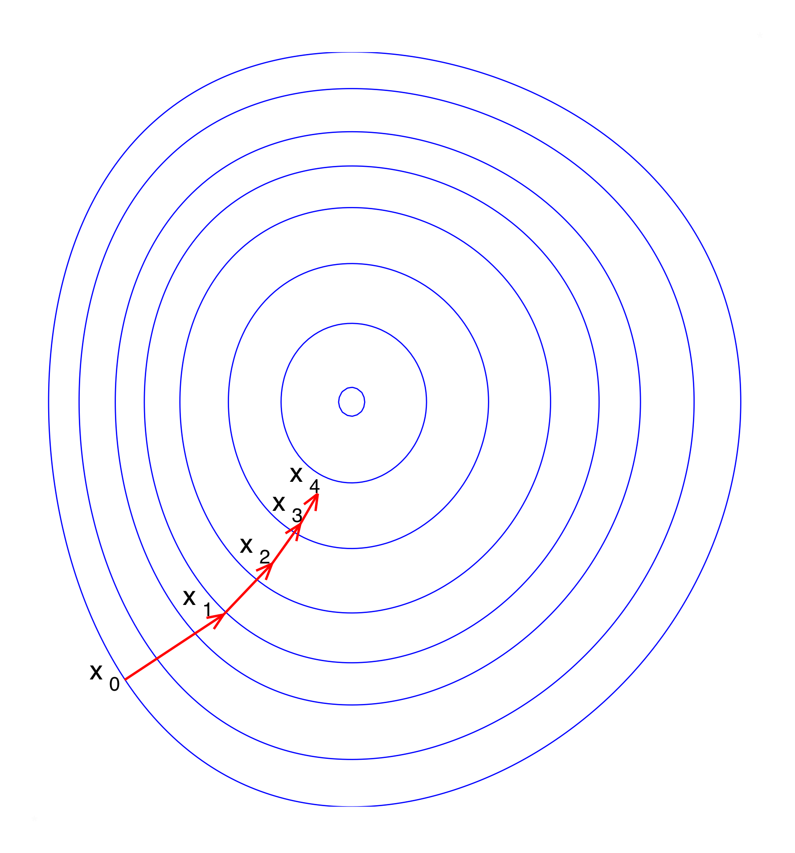
Goal
Image in public domain: https://commons.wikimedia.org/wiki/File:Gradient_descent.svg

Slide 8

Chain image from Chain by Adrien Coquet from the Noun Project CC0

Slide 9
Chain image from Chain by Adrien Coquet from the Noun Project CC0

Slide 10
Adjoint

Slide 11
Adjoint

Slide 12
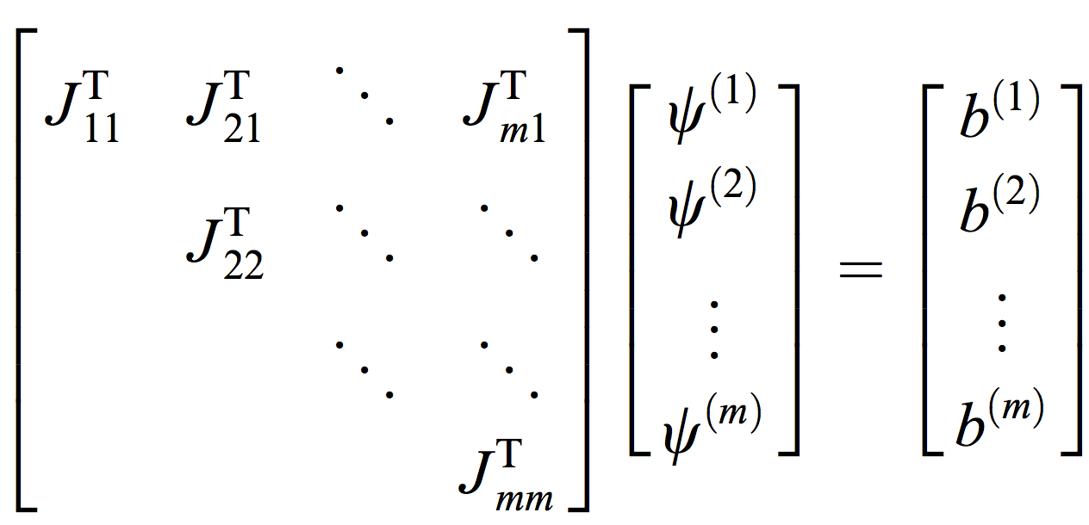
Adjoint
Linear system of equation included from main paper (see title slide)

Slide 13
Adjoint
Linear system of equation included from main paper (see title slide)

Slide 14
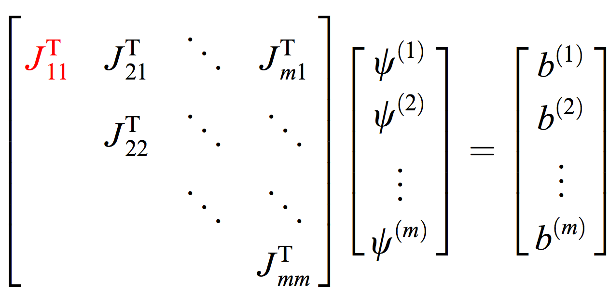
Adjoint
Linear system of equation included from main paper (see title slide)

Slide 15
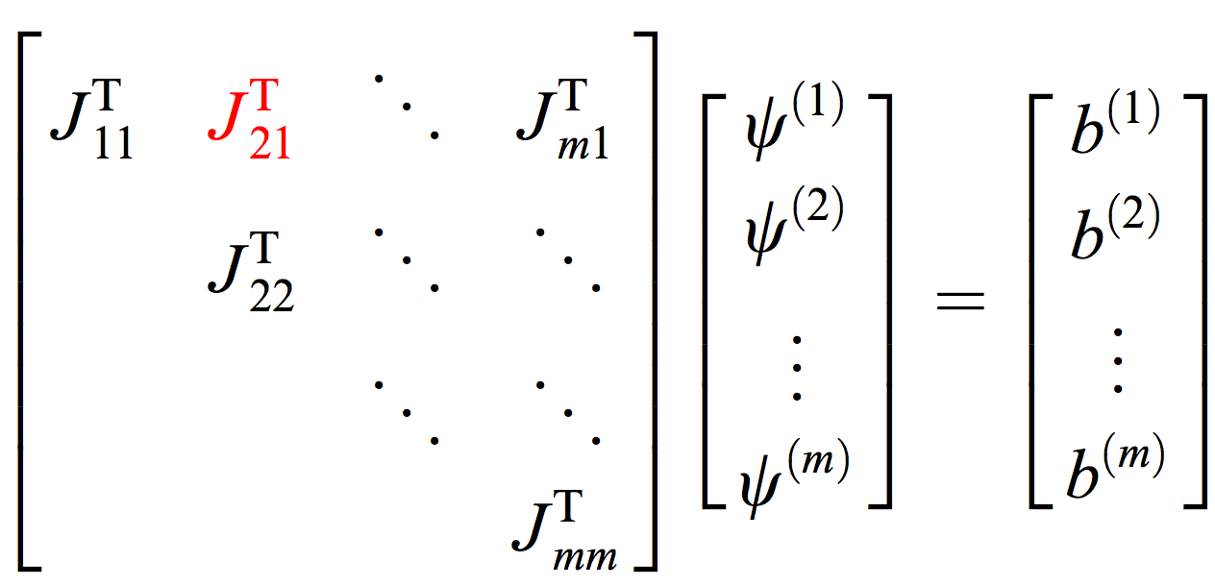
Adjoint
Linear system of equation included from main paper (see title slide)

Slide 16
Monte Carlo
Image in public domain: https://commons.wikimedia.org/wiki/File:Gradient_descent.svg

Slide 17
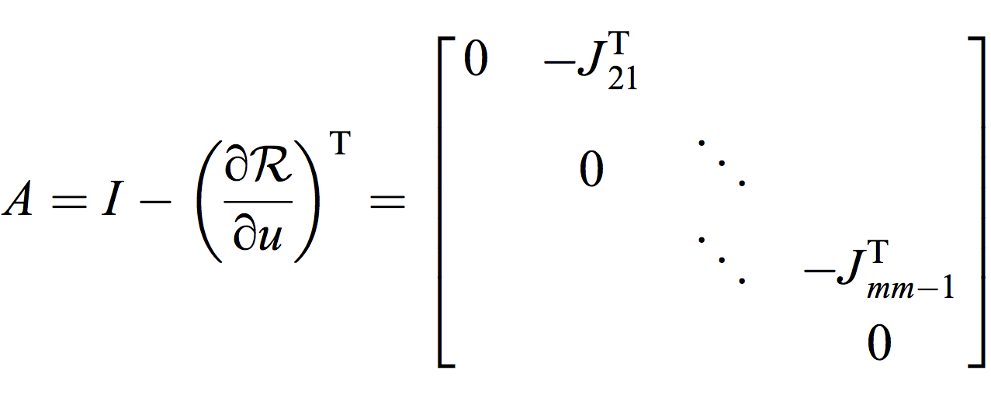
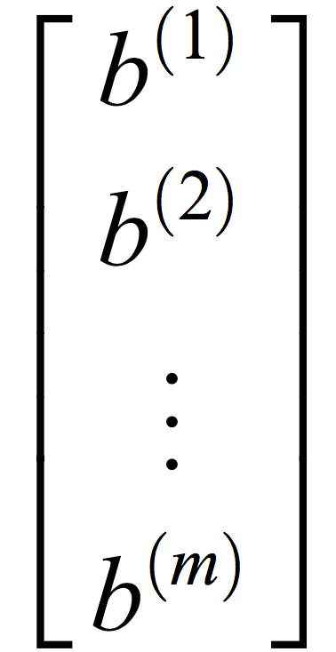
Monte Carlo
Formulas from the main paper (see title slide)

Slide 18
Monte Carlo

Slide 19
Monte Carlo

Slide 20
Test drive

Slide 21
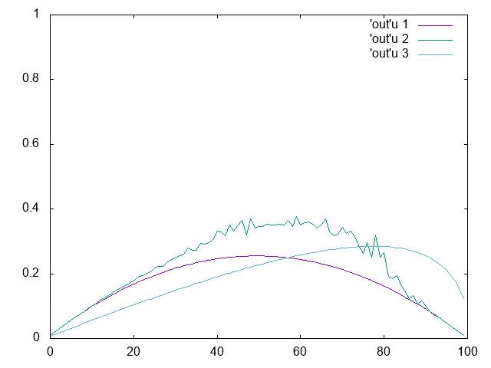
Test drive

